Slide 1
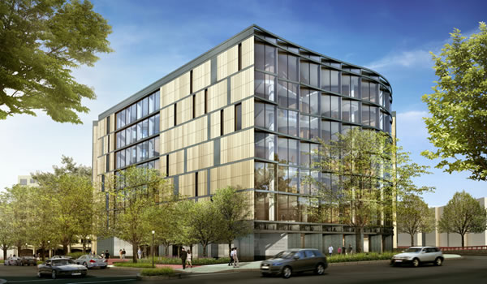
University Health Building
Located in the Mid-Atlantic Region
Thesis Final Presentation
Evan Landis || Structural Option
Advisor || Heather Sustersic

Slide 2
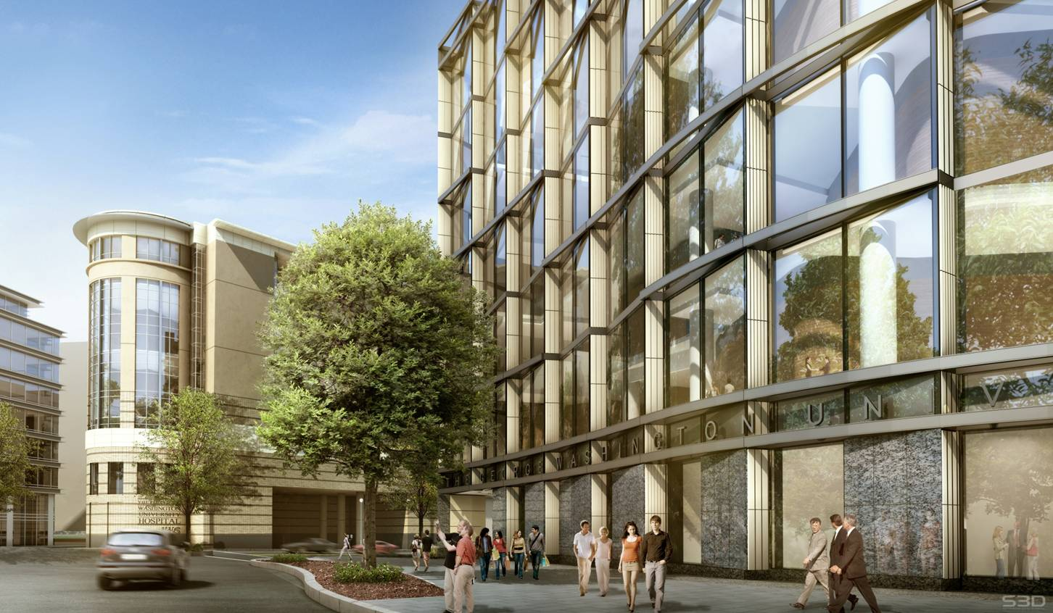
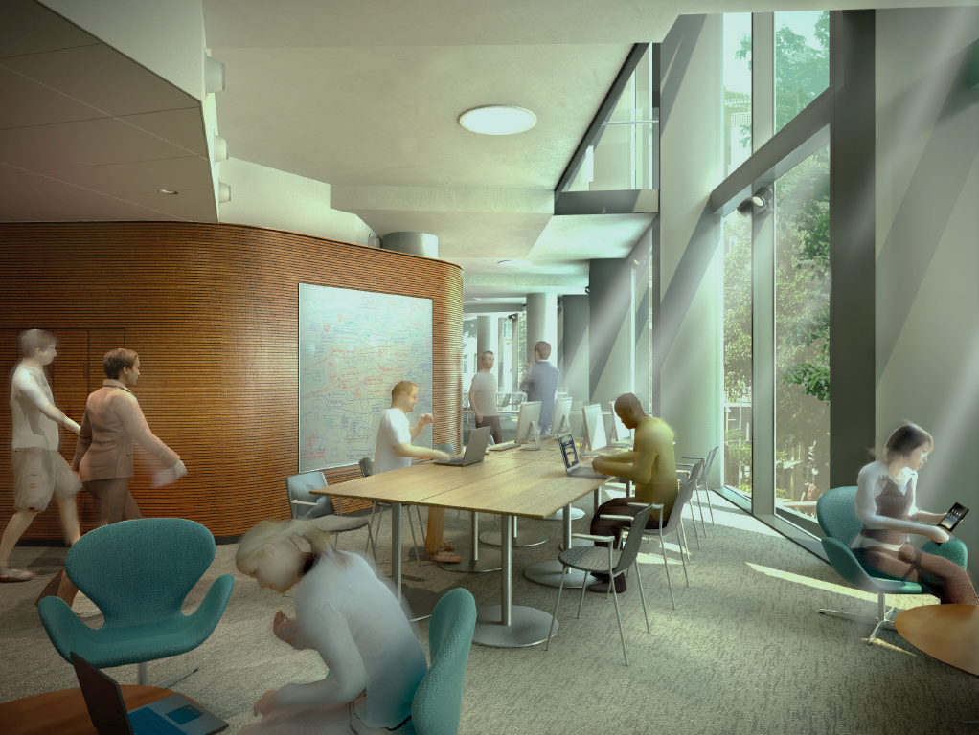
Outline
Introduction
Structural Overview
Thesis Proposal
Lateral System Redesign
Lateral System Cost
Foundation Redesign
Foundation Cost/Schedule
Building Envelope
Conclusion

Slide 3
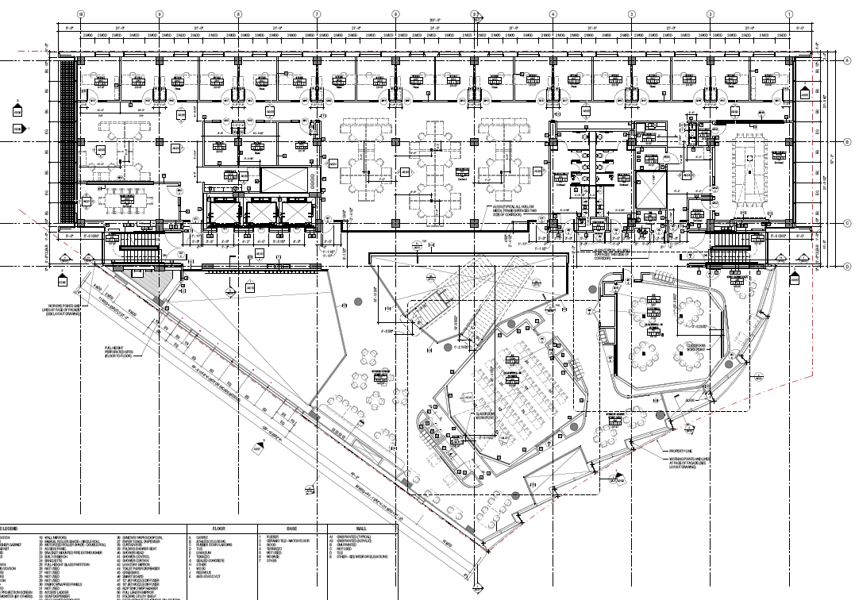
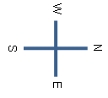
Outline
Introduction
Structural Overview
Proposal
Lateral System Redesign
Lateral System Cost
Foundation Redesign
Foundation Cost/Schedule
Building Envelope
Conclusion
Introduction
Structural Overview
Foundation
Spread footings
Grade beam tie ins for basement retaining walls
Project Info
Cost: $56 Million
Size: 161,000 SF
Floors: 7
Floor Slabs
Two-way post tensioned slabs
f’c = 6-8ksi
Lateral System
Concrete Moment Frames
One Shear wall
Roof System
Green roof on post tensioned slab
- White PVC membrane on post tensioned concrete slab

Slide 4
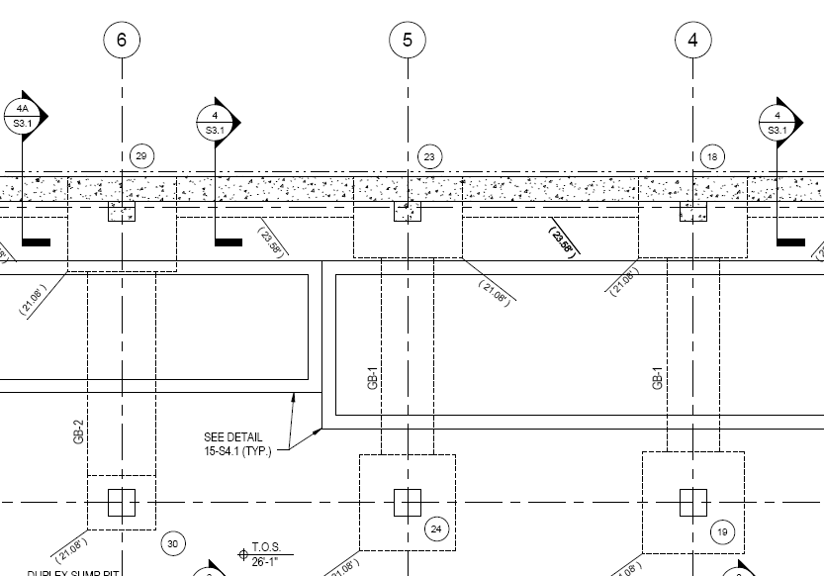
Outline
Introduction
Structural Overview
Proposal
Lateral System Redesign
Lateral System Cost
Foundation Redesign
Foundation Cost/Schedule
Building Envelope
Conclusion
Structural Overview
Structural Overview
Foundation
Spread footings
Grade beam tie ins for basement retaining walls
Foundation
- Spread footings w/ grade beams
Floor Slabs
Two-way post tensioned slabs
f’c = 6-8ksi
Project Info
Cost: $56 Million
Size: 161,000 SF
Floors: 7
Floor Slabs
Two-way post tensioned slabs
f’c = 6-8ksi
Lateral System
Concrete Moment Frames
One Shear wall
Lateral System
Concrete Moment Frames
One Shear wall
Roof System
Green roof on post tensioned slab
- White PVC membrane on post tensioned concrete slab
Roof System
Green roof on post tensioned slab
- White PVC membrane on post tensioned concrete slab

Slide 5
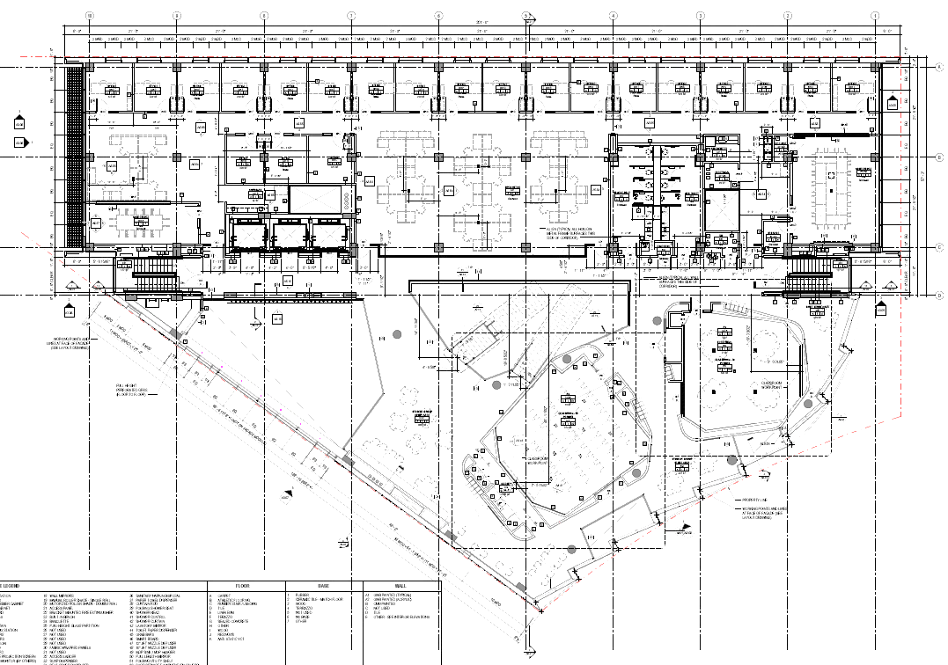
Outline
Introduction
Structural Overview
Proposal
Lateral System Redesign
Lateral System Cost
Foundation Redesign
Foundation Cost/Schedule
Building Envelope
Conclusion
Structural Overview
Structural Overview
Foundation
Spread footings
Grade beam tie ins for basement retaining walls
Foundation
- Spread footings w/ grade beams
Floor Slabs
Two-way post tensioned slabs
f’c = 6-8ksi
Project Info
Cost: $56 Million
Size: 161,000 SF
Floors: 7
Floor Slabs
Two-way post tensioned slabs
f’c = 6-8ksi
Lateral System
Concrete Moment Frames
One Shear wall
Lateral System
Concrete Moment Frames
One Shear wall
Roof System
Green roof on post tensioned slab
- White PVC membrane on post tensioned concrete slab
Roof System
Green roof on post tensioned slab
- White PVC membrane on post tensioned concrete slab

Slide 6
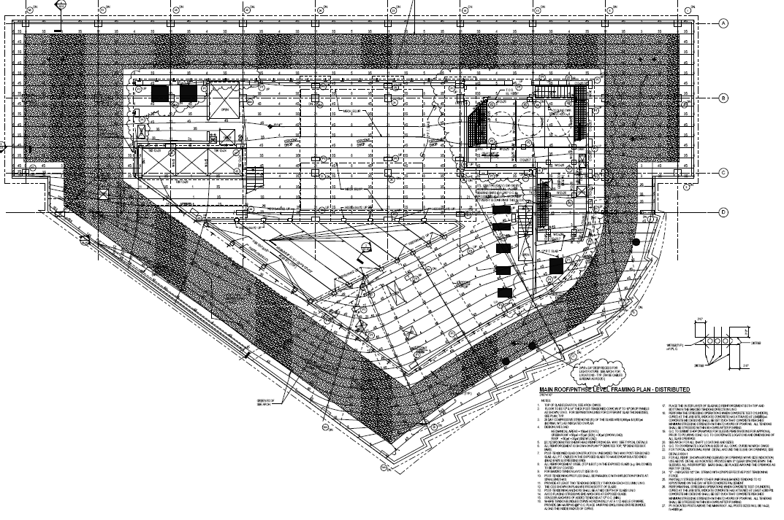
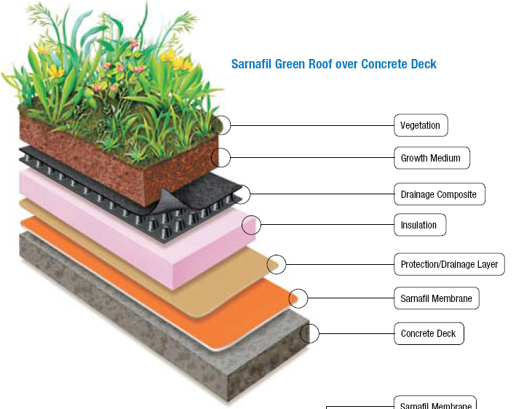
Outline
Introduction
Structural Overview
Proposal
Lateral System Redesign
Lateral System Cost
Foundation Redesign
Foundation Cost/Schedule
Building Envelope
Conclusion
Structural Overview
Foundation
Spread footings
Grade beam tie ins for basement retaining walls
Project Info
Cost: $56 Million
Size: 161,000 SF
Floors: 7
Floor Slabs
Two-way post tensioned slabs
f’c = 6-8ksi
Stair Tower Skylight
Lateral System
Concrete Moment Frames
One Shear wall
Roof System
Green roof on post tensioned slab
- White PVC membrane on post tensioned concrete slab
Image from usa.sarnafil.sika.com

Slide 7
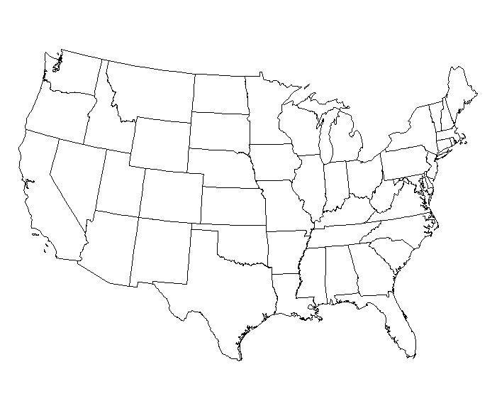

Outline
Introduction
Structural Overview
Thesis Proposal
Lateral System Redesign
Lateral System Cost
Foundation Redesign
Foundation Cost/Schedule
Building Envelope
Conclusion
Thesis Proposal
Structural Depth
- Owners want to open a branch campus in Orlando, Florida
Building Envelope Analysis
Determine the condensation point in a typical wall section
Determine if the R-Value meets minimum standards for new location
Scope
Lateral System Analysis
Foundations check
Cost/Schedule Analysis Breadth
To determine the cost associated with the changes to the lateral and foundation systems
Determine the increase to the building schedule due to changes
Mae Requirements
AE 530 Computer Modeling of Building Structures
AE 542 Building Enclosure Science and Design

Slide 8
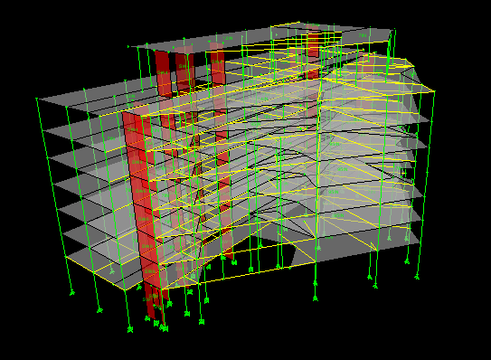
Outline
Introduction
Structural Overview
Thesis Proposal
Lateral System Redesign
Lateral System Cost
Foundation Redesign
Foundation Cost/Schedule
Building Envelope
Conclusion
Structural Depth
Etabs model
All structural elements were modeled
Modulus of Elasticity was halved to allow for the inelastic response of concrete members
Live Loads and Superimposed Dead Loads were placed on the model
Floor Slabs modeled as rigid diaphragms
Shear walls modeled as membrane elements

Slide 9
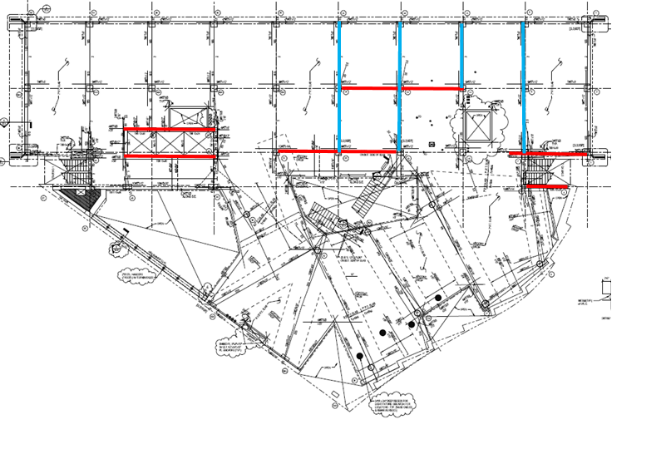
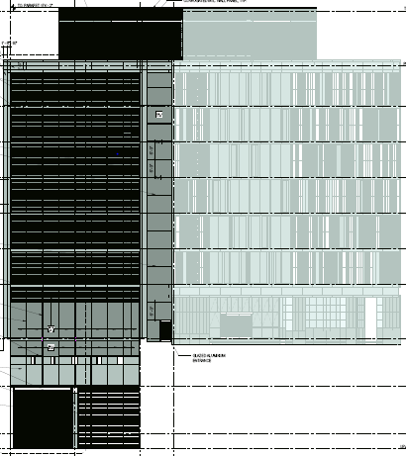
Outline
Introduction
Structural Overview
Thesis Proposal
Lateral System Redesign
Lateral System Cost
Foundation Redesign
Foundation Cost/Schedule
Building Envelope
Conclusion
Structural Depth
Story Forces
80.26k
Original Lateral System
Designed for seismic loading
Very few moment frames due to column discontinuities
194.84k
105.00k
83.32k
68.17k
53.21k
37.89k
22.32k
N
W
E
W
E
S
NS Moment Frames
48,000ft-k
EW Moment Frames
650k
EW Shear Wall

Slide 10
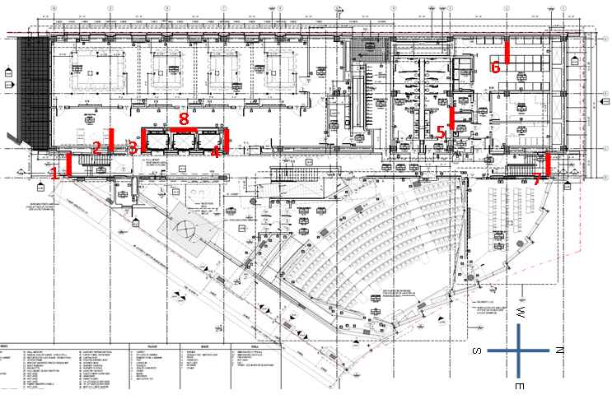
Outline
Introduction
Structural Overview
Proposal
Lateral System Redesign
Lateral System Cost
Foundation Redesign
Foundation Cost/Schedule
Building Envelope
Conclusion
Structural Depth
Story Forces
Lateral System Additions
Designed for wind velocity of 145mph (Orlando Building Code)
Addition of (7) 12” thick shear walls of varying lengths
Alterations to existing shear wall
h/400 = 3.3”
200k
341k
324k
310k
304k
294k
283k
322k
W
E
119,000ft-k
2000k

Slide 11
Outline
Introduction
Structural Overview
Thesis Proposal
Lateral System Redesign
Lateral System Cost
Foundation Redesign
Foundation Cost/Schedule
Building Envelope
Conclusion
Structural Depth
Story Forces
Lateral System Additions
Designed for wind velocity of 145mph (Orlando Building Code)
Addition of (7) 12” thick shear walls of varying lengths
Alterations to existing shear wall
h/400 = 3.3”
200k
341k
324k
310k
304k
294k
East-West
North-SOuth
13.5”
3.2”
283k
3.6”
3.0”
322k
W
E
119,000ft-k
2000k
Original System
New System
Original System
New System

Slide 12

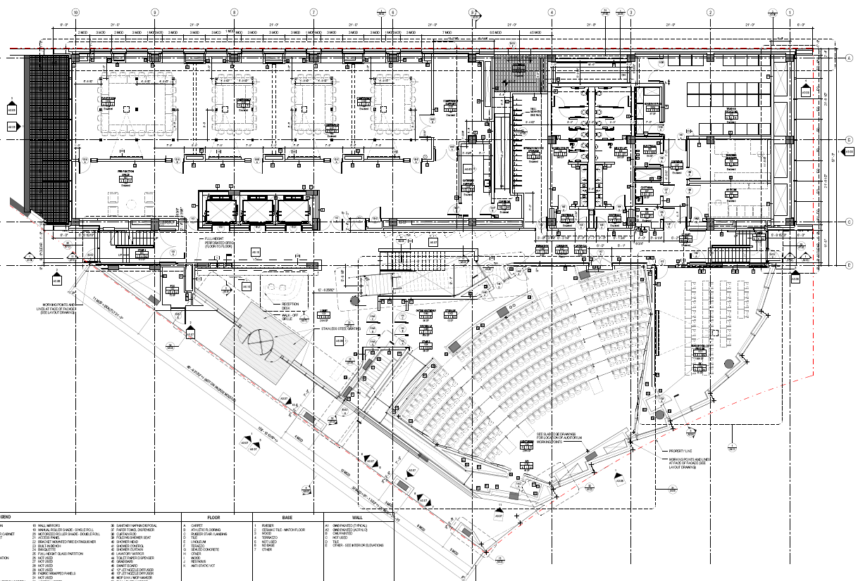
Outline
Introduction
Structural Overview
Thesis Proposal
Lateral System Redesign
Lateral System Cost
Foundation Redesign
Foundation Cost/Schedule
Building Envelope
Conclusion
Structural Depth
Story Forces
Shear Wall Design
Designed with boundary elements
Walls of same length designed with same
rebar configuration for ease of construction
Typ. (6) or (8) #9’s or #10’s in boundary element
#5’s @ 12” Vertical
#5’s @ 12” Horizontal
200k
341k
6
324k
8’
310k
10’
8
COR
5
304k
2
3
4
11’
294k
1
7
283k
322k
W
E
N
119,000ft-k
W
E
2000k
Boundary Element
S
Temperature/Shrinkage and Shear Reinforcing

Slide 13
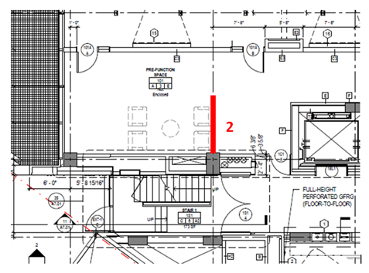
Outline
Introduction
Structural Overview
Thesis Proposal
Lateral System Redesign
Lateral System Cost
Foundation Redesign
Foundation Cost/Schedule
Building Envelope
Conclusion
Structural Depth
Pre-function Space
Shear Wall Placement
Main goal was to not disrupt the architectural flow of the building
Could not be avoided entirely
6
8
5
2
3
4
1
7
N
W
E
S

Slide 14
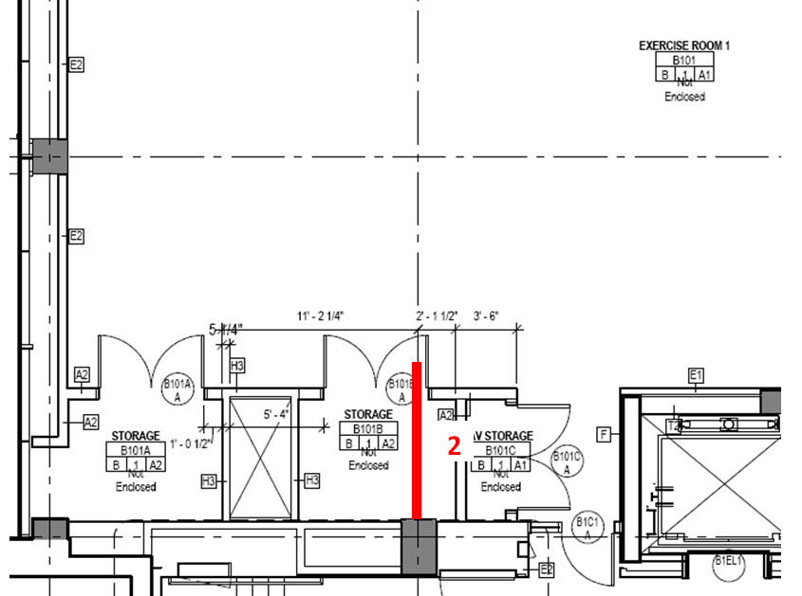
Outline
Introduction
Structural Overview
Thesis Proposal
Lateral System Redesign
Lateral System Cost
Foundation Redesign
Foundation Cost/Schedule
Building Envelope
Conclusion
Structural Depth
Pre-function Space
Shear Wall Placement
Main goal was to not disrupt the architectural flow of the building
Could not be avoided entirely
6
8
5
2
3
4
1
7
Exercise Room
(2) Storage Closets
AV Storage
N
W
E
S

Slide 15
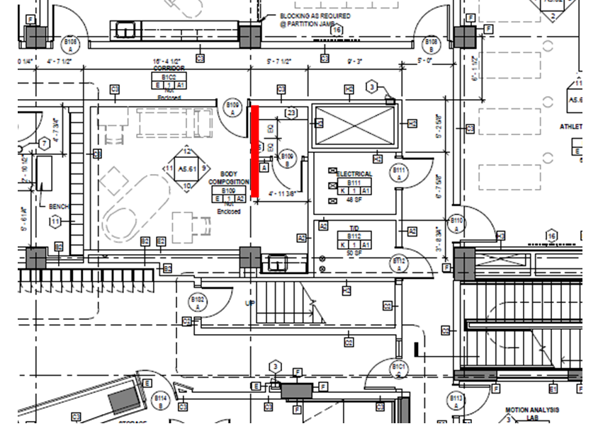
Outline
Introduction
Structural Overview
Thesis Proposal
Lateral System Redesign
Lateral System Cost
Foundation Redesign
Foundation Cost/Schedule
Building Envelope
Conclusion
Structural Depth
Body Composition Room
5
Shear Wall Placement
Main goal was to not disrupt the architectural flow of the building
Could not be avoided entirely
6
8
5
2
3
4
1
7
N
W
E
S

Slide 16
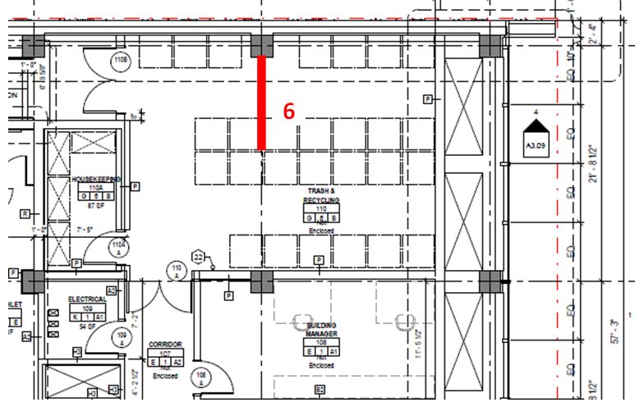
Outline
Introduction
Structural Overview
Thesis Proposal
Lateral System Redesign
Lateral System Cost
Foundation Redesign
Foundation Cost/Schedule
Building Envelope
Conclusion
Structural Depth
Body Composition Room
5
Shear Wall Placement
Main goal was to not disrupt the architectural flow of the building
Could not be avoided entirely
6
8
5
2
3
4
1
7
Trash and Recycling Room
N
W
E
S

Slide 17
Outline
Introduction
Structural Overview
Thesis Proposal
Lateral System Redesign
Lateral System Cost
Foundation Redesign
Foundation Cost/Schedule
Building Envelope
Conclusion
Cost/Schedule Breadth
Shear Wall Cost Includes
4-10ksi concrete
Rebar
Formwork
Pumping
Shear Wall Schedule: Negligible
Placement
Finishing
6
8
5
2
3
4
1
7
N
W
E
S

Slide 18
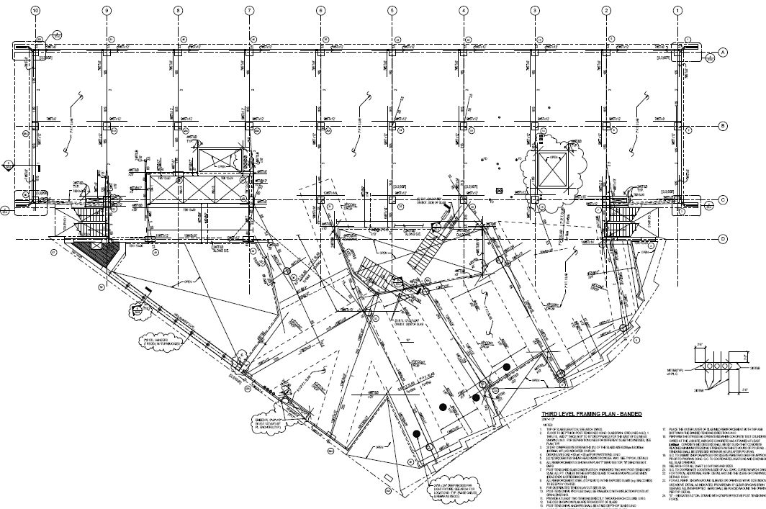
Outline
Introduction
Structural Overview
Thesis Proposal
Lateral System Redesign
Lateral System Cost
Foundation Redesign
Foundation Cost/Schedule
Building Envelope
Conclusion
Structural Depth
Original Foundation
Spread footings
Soil Bearing Capacity: 30ksf bedrock
Typical sizes: 6x6, 5x4, 9x9
f’c = 5ksi
Goals
Design new spread footings for single shear walls and typ. column
To determine percent increase to size
N
W
E
S

Slide 19

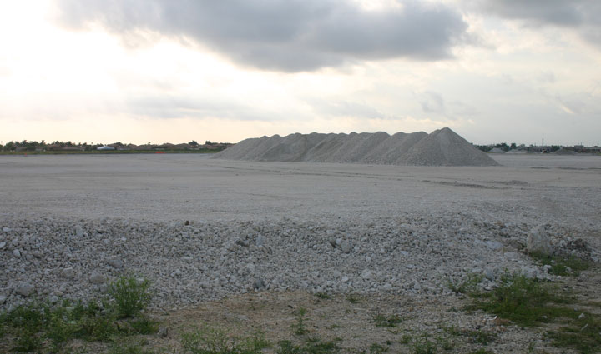

Outline
Introduction
Structural Overview
Thesis Proposal
Lateral System Redesign
Lateral System Cost
Foundation Redesign
Foundation Cost/Schedule
Building Envelope
Conclusion
Structural Depth
Foundation Design
Trial 1: Spread footings on soil: 2-3ksf
  Not suitable for loading
Trial 2: Spread footings on structural fill: 8ksf
  Typ. Column: 12x12
  Typ. Shear Wall: no good
Trial 3: 50ft Caissons: 20ksf bedrock
www.gardenswag.com
Sandy Soil
www.fairchildgarden.org
Structural Fill
www.fairchildgarden.org
Bedrock
hirise.lpl.arizona.edu

Slide 20
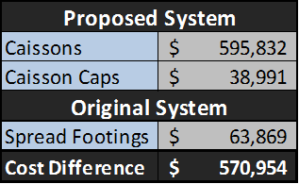
Outline
Introduction
Structural Overview
Thesis Proposal
Lateral System Redesign
Lateral System Cost
Foundation Redesign
Foundation Cost/Schedule
Building Envelope
Conclusion
Cost/Schedule Breadth
Foundation Cost Incudes
3ksi concrete caisson
5ksi concrete cap
Casing and Pumping
Excavation
Foundation Schedule
1 caisson per column
2 caissons per shear wall
Original number of spread footings
Mobilization
Haul excess excavation
Inspection
Equipment
www.fairchildgarden.org
22 Days

Slide 21
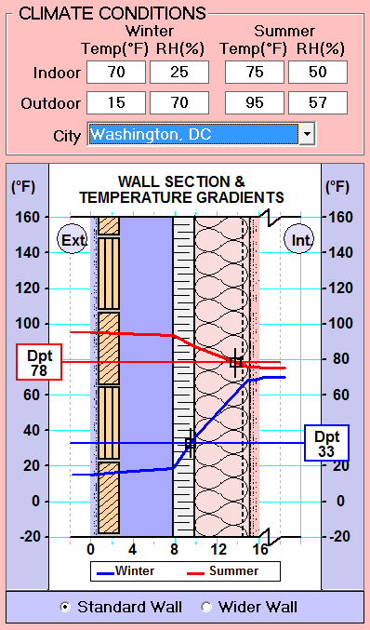
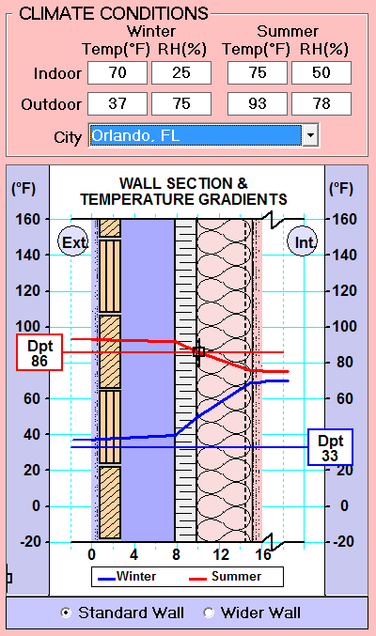
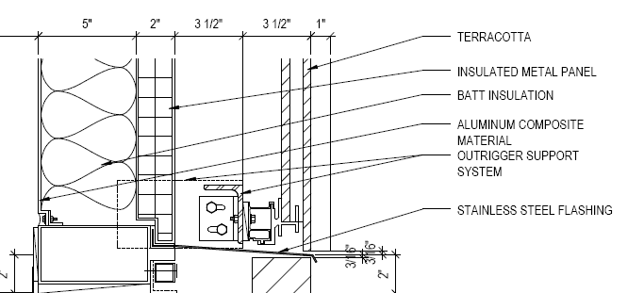
Outline
Introduction
Structural Overview
Thesis Proposal
Lateral System Redesign
Lateral System Cost
Foundation Redesign
Foundation Cost/Schedule
Building Envelope
Conclusion
Building Envelope Breadth
Condensation Analysis
To determine if typical wall section will work in the humid Orlando Climate
Mid-Atlantic
www.fairchildgarden.org

Slide 22
Outline
Introduction
Structural Overview
Thesis Proposal
Lateral System Redesign
Lateral System Cost
Foundation Redesign
Foundation Cost/Schedule
Building Envelope
Conclusion
Building Envelope Breadth
R-Value Analysis
ASHRAE 90.1 Energy Standard for Buildings
R-Value does not include Terra Cotta
www.fairchildgarden.org

Slide 23
Outline
Introduction
Structural Overview
Thesis Proposal
Lateral System Redesign
Lateral System Cost
Foundation Redesign
Foundation Cost/Schedule
Building Envelope
Conclusion
Conclusion
Lateral system
7 new shear walls
1 updated shear wall
Foundation
- Change from spread footings to caissons
Building Envelope
- No changes necessary
www.fairchildgarden.org
Cost
Shear Walls $119,000
Foundations +$571,000
        $690,000

Slide 24
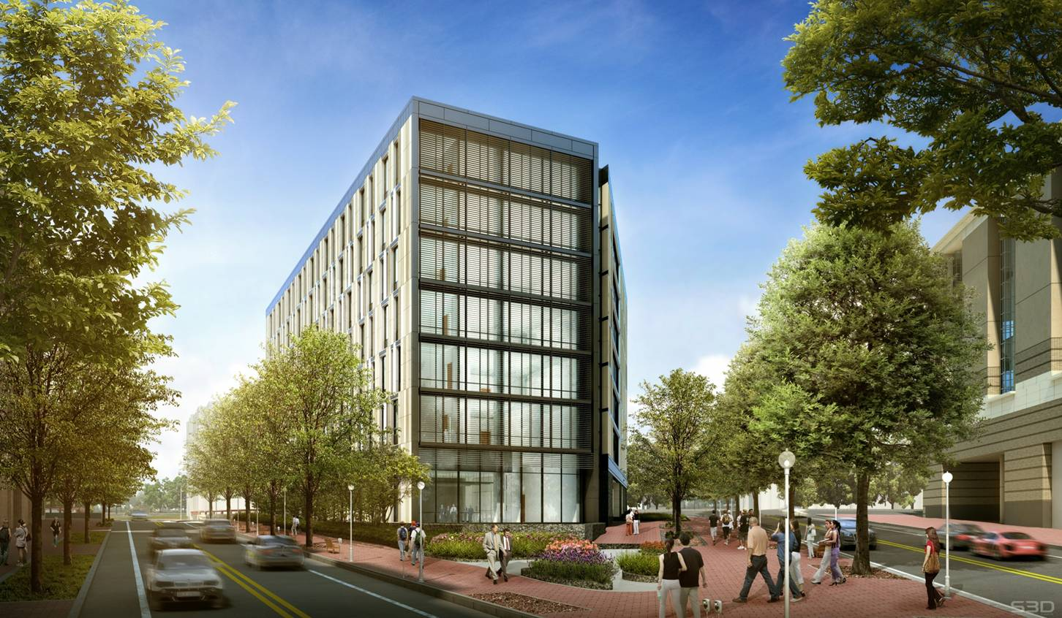




Questions?
Special Thanks to the ones that made this possible:
www.fairchildgarden.org

Slide 25
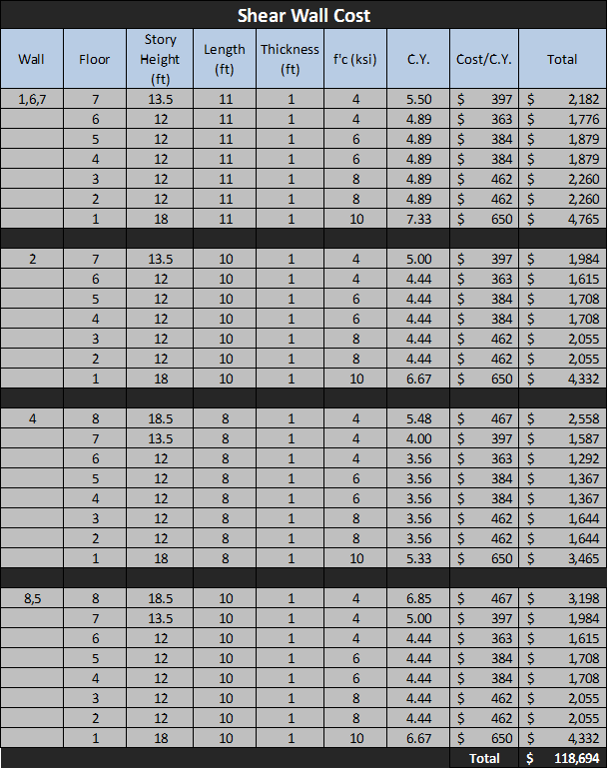
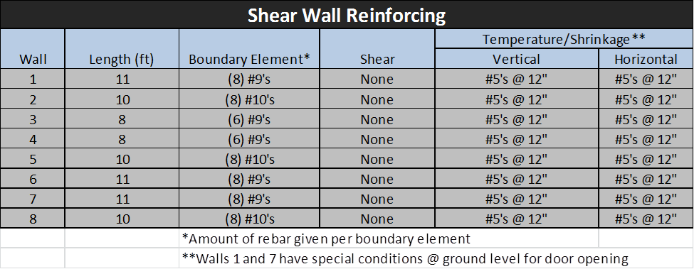
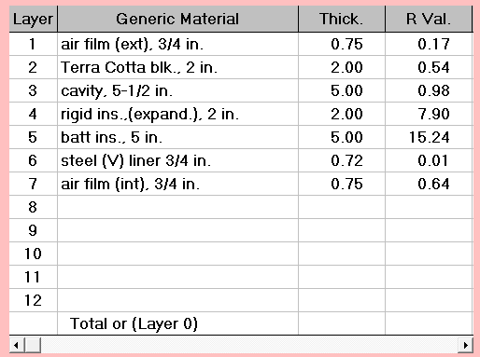
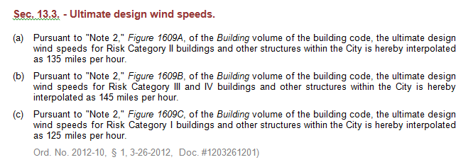
Appendix
www.fairchildgarden.org
Orlando Florida Building Code

Slide 26
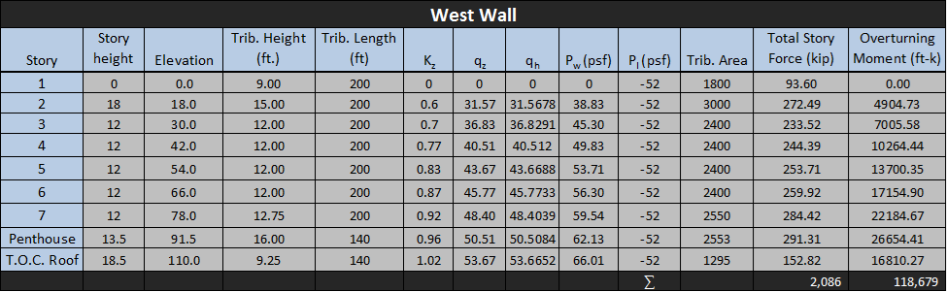
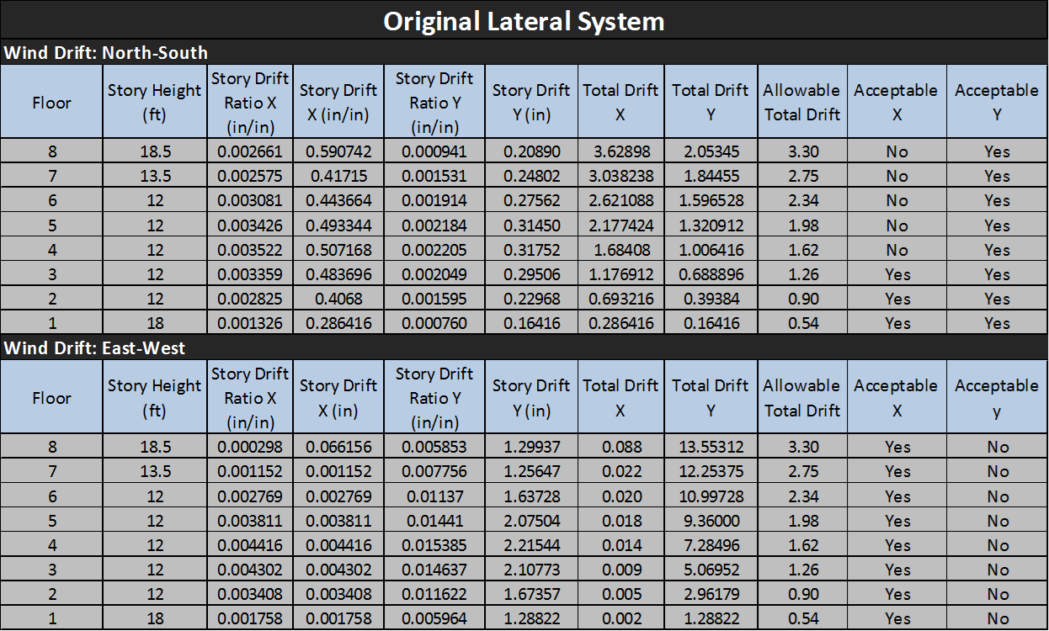
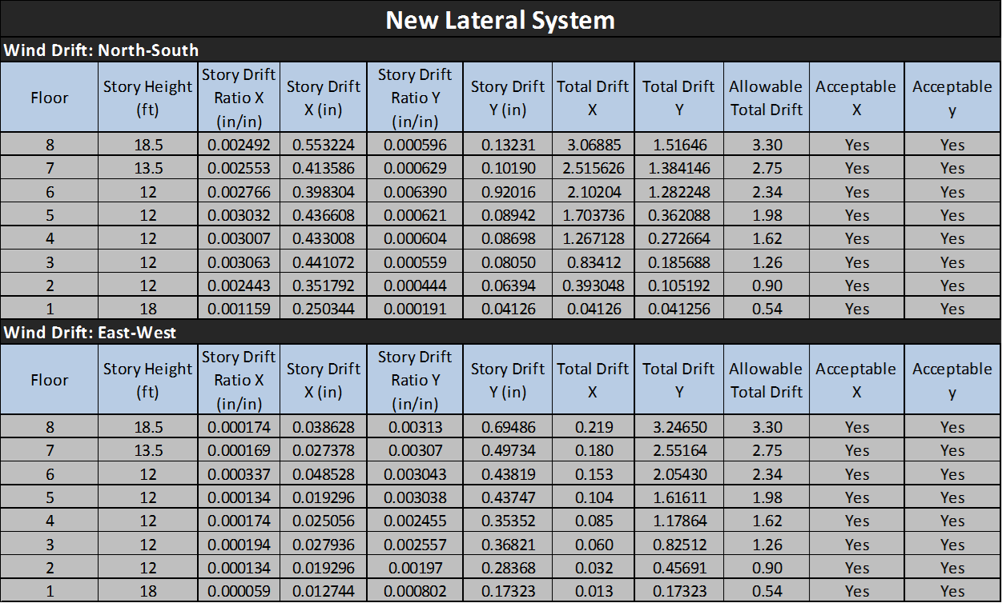
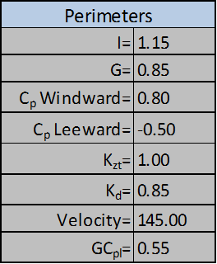
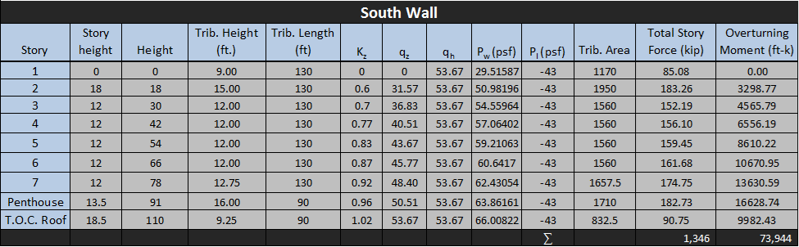
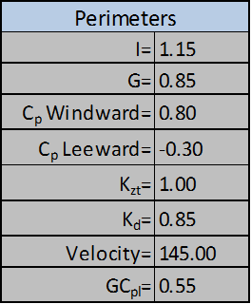
Appendix
www.fairchildgarden.org

Slide 27
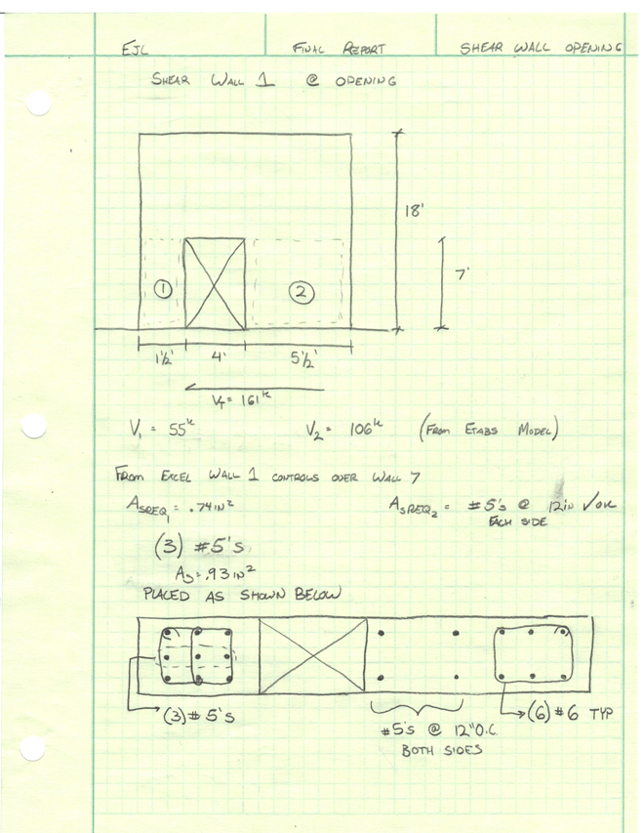
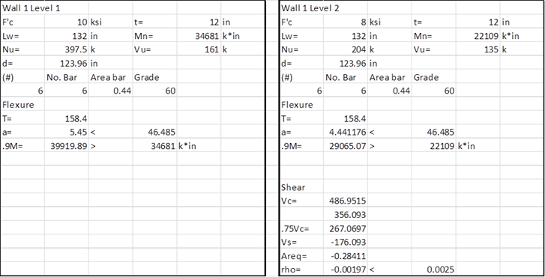
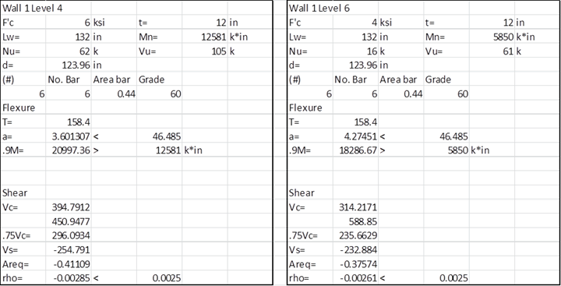
Appendix
www.fairchildgarden.org

